Slide 1
Digital Logic & Design
Lecture 04

Slide 2
Binary Multiplication
1101 (13)
x 101 (5)
1st product term 1101
2nd product term 0000x
3rd product term 1101xx
Product 1000001 (65)
Notes:
Binary multiplication is identical to the decimal multiplication.
The first product term results in 1101
The second product term results in 0000 and is written shifted left by 1 bit
The third product term results in 1101 and is written shifted left by 2 bits
The product result is sum of all the partial product terms

Slide 3
Multiplication by shifting left
Decimal 29 shifted left by one digit
290
Shift left 1 digit is multiply by 10
Binary 11101₂ (29) shifted left by one bit
111010₂ (58)
Shift left 1 bit is multiply by 2
Notes:
Multiplication operations can be performed by shifting a number towards left.
For example decimal 29 shifted left by 1 digit is like multiplying by 10
Shifting 29 by two digits towards left is multiplying by 10² or 100
Each shift left operation in decimal is equivalent to multiplying a number by 10.
In a binary number system, each left shift is equivalent to multiplying by 2.
Shifting 11101₂ twice towards left is 1110100₂ which is multiply by 4.

Slide 4
Binary Division(OPTIONAL)
10
101 | 1101
101
011
000
11
2
5 | 13
10
3
Notes:
Binary division follows the same rules as in decimal division.
https://www.youtube.com/watch?v=KGMf314LUc0&t=508s
https://www.youtube.com/watch?v=LGqBQrUYua4
https://www.youtube.com/watch?v=HdU_rf7eMTI
The binary division divides 1101₂ (13) by 101₂ (5) which results in a quotient value of 10₂ (2) and a remainder 11₂ (3) which is in confirmation with equivalent decimal division.

Slide 5
Binary Division(OPTIONAL)
10
11 | 110
110
0
11
10 | 110 10
10
10
0
Notes:
Binary division follows the same rules as in decimal division.
The binary division divides 1101₂ (13) by 101₂ (5) which results in a quotient value of 10₂ (2) and a remainder 11₂ (3) which is in confirmation with equivalent decimal division.

Slide 6
Division by shifting right
Decimal 29 shifted right by one digit
2.9
Shift left 1 digit is divide by 10
Binary 11101₂ (29) shifted left by one bit
1110.1₂ (14.5)
Shift left 1 bit is divide by 2
Notes:
Division operations can be performed by shifting a number towards right.
For example decimal 29 shifted right by 1 digit is like dividing by 10
Shifting 29 by two digits towards right is dividing by 10² or 100
Each shift right operation in decimal is equivalent to dividing a number by 10.
In a binary number system, each right shift is equivalent to dividing by 2.
Shifting 11101₂ twice towards right is 111.01₂ which is divide by 4.

Slide 7

Signed and Unsigned Numbers
Unsigned Binary Numbers
Signed Binary Numbers
  Most significant bit represents sign
  0 represents a positive number
  1 represents a negative number
Notes:
Digital systems should be able to handle positive and negative numbers.
So far we have only considered positive binary numbers.
How does the digital system represent the + or – symbol?
To handle positive and negative binary numbers, the digital system sets aside the most significant digit (bit) to represent the sign
MSB set to 1 indicates a negative number
MSB set to 0 indicates a positive number
Thus +13 and -13 are represented as 01101 and 11101 respectively.
Digital systems handle two different types of binary numbers, signed and unsigned.
Thus 11101₂ represents -13 in signed binary and 29 in unsigned binary.
The digital system has to be told beforehand to deal with a binary number as signed or unsigned.

Slide 8
1’s Complement form
The 1’s complement of a binary number is found by changing all 1’s to 0’s and all 0’s to 1’s
Binary number 0 1 1 0 1
1’s complement 1 0 0 1 0
Notes:
Informing the digital system beforehand to deal with a number as signed or unsigned is inconvenient
Signed binary numbers are represented in their 2’s complement form.
A 2’s complement of a binary number is achieved by first taking the 1’s complement of a number followed by its 2’s complement.
The 1’s complement of a binary number is obtained by simply inverting each bit.
The 2’s complement of a binary number is obtained by adding a 1 to the 1’s complement of the original number.
In a 2’s complement form all negative binary numbers are represented in their 2’s complement form
All such negative numbers have their most significant bit set to 1 signifying a negative number.
All positive numbers are represented in their original form.
Their most significant bit is a 0 specifying a positive number.

Slide 9
2’s Complement form
The 2’s complement of a binary number is found by adding 1 to LSB of 1’s complement.
2’s complement = (1’s complement) + 1
Binary number 01101 (13)
1’s complement 10010
+ 1
2’s complement 10011 (-13)
Notes:
Informing the digital system beforehand to deal with a number as signed or unsigned is inconvenient
Signed binary numbers are represented in their 2’s complement form.
A 2’s complement of a binary number is achieved by first taking the 1’s complement of a number followed by its 2’s complement.
The 1’s complement of a binary number is obtained by simply inverting each bit.
The 2’s complement of a binary number is obtained by adding a 1 to the 1’s complement of the original number.
In a 2’s complement form all negative binary numbers are represented in their 2’s complement form
All such negative numbers have their most significant bit set to 1 signifying a negative number.
All positive numbers are represented in their original form.
Their most significant bit is a 0 specifying a positive number.

Slide 10

2’s Complement form
Alternative method
Start at the right with the LSB and write the bits as they are up to and including the first 1
Take the 1’s complement of the remaining bits
Notes:
Informing the digital system beforehand to deal with a number as signed or unsigned is inconvenient
Signed binary numbers are represented in their 2’s complement form.
A 2’s complement of a binary number is achieved by first taking the 1’s complement of a number followed by its 2’s complement.
The 1’s complement of a binary number is obtained by simply inverting each bit.
The 2’s complement of a binary number is obtained by adding a 1 to the 1’s complement of the original number.
In a 2’s complement form all negative binary numbers are represented in their 2’s complement form
All such negative numbers have their most significant bit set to 1 signifying a negative number.
All positive numbers are represented in their original form.
Their most significant bit is a 0 specifying a positive number.

Slide 11
Addition and Subtraction with 2’s Complement
0101 +5 0101 +5
0010 +2 1110 -2
0111 +7 0011 +3
1011 -5 1011 -5
1110 -2 0010 +2
1001 -7 1101 -3
Notes:
There are four cases of addition
Both numbers are positive
0101 +5
0010 +2
0111 +7
Both numbers are negative
1011 -5
1110 -2
1001 -7 the carry generated from the msb is discarded
One number is positive and its magnitude is larger than the negative number
0101 +5
1110 -2
0011 +3 the carry generated from the msb is discarded
One number is positive and its magnitude is smaller than the negative number
1011 -5
0010 +2
1101 -3
By using signed number based on 2’s complement the addition operation serves to add and subtract numbers.

Slide 12
Range of Numbers
Maximum Range
Number of digits
Decimal number example
Binary number example
Overflow
Notes:
The maximum range of values that can be represented in any number system depends upon the number of digits assigned to represent the value.
A 6-digit car odometer can only count up to 999999 and then it rolls back to 000000.
Similarly an 8-digit calculator can only handle integer numbers of the magnitude 99999999.
A calculator that reserves the most significant digit to write + or – can only handle a maximum range of integer numbers from -9999999 to +9999999.
A 3-bit unsigned binary number can have values ranging between 000 and 111.
The total number of values are 8.
A simple formula can used to determine the total number of unsigned value represented by n binary bits. 2^{n}
The magnitude of the largest binary number that can be represented is one less than the total number or range of values, 2^{n} -1
If 100 and 111 unsigned numbers are added which give a result 1011, this result is considered to be out of range as 4 bits are required.

Slide 13
Range of Binary Numbers
Decimal Number | Sign Magnitude 2^{n-1} -1 | 2’s Complement 2^{n-1} -1 | Unsigned 2^{n} - 1
0 | 0000 | 0000 | 000
1 | 0001 | 0001 | 001
2 | 0010 | 0010 | 010
3 | 0011 | 0011 | 011
4 | 0100 | 0100 | 100
5 | 0101 | 0101 | 101
6 | 0110 | 0110 | 110
7 | 0111 | 0111 | 111
Notes:
Binary numbers can be represented in three different formats or methods
Unsigned
Signed
2’s complement
In the unsigned method only positive numbers can be represented.
To represent positive numbers from 0 to 7, a 3-bit binary combination is required.
In the signed method an extra bit, the most significant bit is used to represent the sign of the number.
0 as the sign bit represents a positive number
1 as the sign bit represents a negative number
Thus the signed representation of numbers 0 to 7 requires 4-bit binary combination.
The 2’s complement representation only converts the negative values into their respective 2’s complement form, the positive values remain in their original form.
Four bits are required to represent positive numbers 0 to 7 in their 2’s complement form.

Slide 14
Range of Binary Numbers
Decimal Number | Sign Magnitude -(2^{n-1} -1) | 2’s Complement -2^{n-1} | Unsigned
-8 |  | 1000
-7 | 1111 | 1001
-6 | 1110 | 1010
-5 | 1101 | 1011
-4 | 1100 | 1100
-3 | 1011 | 1101
-2 | 1010 | 1110
-1 | 1001 | 1111
Notes:
In the unsigned form, negative numbers can not be represented thus numbers -1 to -8 have no unsigned binary representation
In the signed representation the most significant bit is used to represent the sign of the number.
Thus 4-bit signed binary representation is used to represent numbers -1 to -7.
The most significant sign bit is 1 for all the negative numbers
-8 can not be represented using 4-bits as the number 8 in its unsigned form requires 4-bits 1000. Representing -8 in signed format requires 5 bits 11000.
In the 2’s complement form the numbers -1 to -8 can be represented in their 2’s complement form using 4 bits.
A 4-bit sign magnitude number can handle a number range between -7 and +7. -8 can not be represented as 5-bits are required 11000.
A 4-bit 2’s complement based signed number range is between -8 to +7.
Let us find out the best way to store numbers. Since both negative and positive numbers are required, thus the unsigned binary representation is not appropriate as negative numbers can not be represented.
The signed magnitude method although capable of representing both negative and positive numbers however the total range of numbers is one less than the 2’s complement method.
Secondly, direct addition and subtraction of numbers using the signed magnitude representation does not give the actual result. It has to be converted back into signed magnitude format.
2,s complement based representation is the most efficient in terms of range of numbers and the fact that add and subtract operations directly result in a value which is represent able in 2’s complement number system without any translation or change.

Slide 15
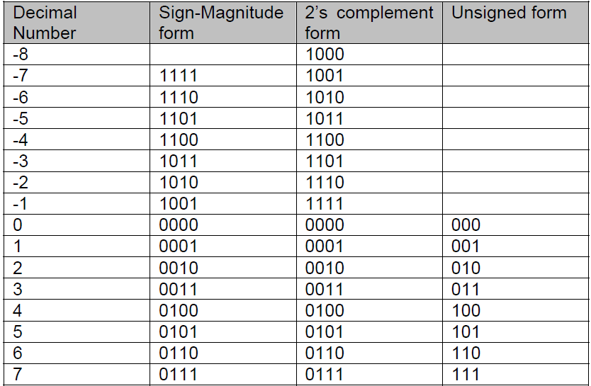
Range of Numbers
Notes:
What happens if you perform addition of 2 and 7 using unsigned representation?
The answer is 9 and it can not be represented using 3-bit unsigned binary numbers.
An Overflow has occurred.

Slide 16
Complements
In computers, the representation and manipulation of –ve numbers is often performed using complements
Complements for a radix come in two forms
  R’s complement (Radix complement)
  (r-1)’s complement (Diminished radix complement)
For binary system -- 2’s complement, & 1’s complement

Slide 17
R’s complement (Radix complement)
Given a +ve number N with n digits
N = (a_{n-1}a_{n-2} …..a₀ )
r’s complement is defined as
= r ^{n} –N for N ≠0; zero otherwise
  Where r is RADIX or Base
  n is number of digits
  N is Number whose R’s complement is required

Slide 18
R’s complement (Radix complement)
EXAMPLE FOR BASE 10
  N=(37218)₁₀ find R’s complement
  =r ^{n} –N
  where r=10 , n=5, N=37218
  = 10⁵ –37218
  =100000-37218
  = 62782

Slide 19
R’s complement (Radix complement)
EXAMPLE FOR BASE 2
  N (101110)² find R’s complement
  =r ^{n} –N
  where r=10 , n=5, N=37218
  = 2⁶ –101110
  = 64¹⁰–101110=1000000- –101110
= 010010

Slide 20
(r-1)’s Complement
Diminished Radix Complement
Given a +ve number N with n digits
N = (a_{n-1}a_{n-2} …..a₀ )
r’s complement is defined as
r ^{n} –1- N
  Where r is RADIX or Base
  n is number of digits
  N is Number whose R’s complement is required

Slide 21
(r-1)’s Complement
Diminished Radix Complement
EXAMPLE FOR BASE 10
  N=(37218)₁₀ find R’s complement
  =r ^{n} –1-N
  where r=10 , n=5, N=37218
  = 10⁵ –1-37218
  =100000-1-37218=99999-37218
  = 62781

Slide 22
(r-1)’s Complement
Diminished Radix Complement
EXAMPLE FOR BASE 2
  N (101110)² find R’s complement
  =r ^{n} –1-N
  where r=10 , n=5, N=37218
  = 2⁶ –1-101110
  = 64¹⁰–101110=1000000-1 –101110
  =111111 –101110
= 010011

